Slide 1
Artificial Intelligence

Slide 2
”Artificial Intelligence (AI) is not the solution to everything, but its disruptive innovation gives us the opportunity to make the world better for everyone”
Andrew NG
Co-founder of Coursera,
Adjunct Professor of Stanford
(regarded as one of the world’s foremost experts on AI)

Slide 3
What is AI?
Intelligence: “ The ability to learn and solve problems”
Artificial Intelligence: AI is the simulation of human intelligence by machines
The science and engineering of building "intelligent" software agents.
AI - is the reproduction of human reasoning and intelligent behavior by computational methods
Think like humans | Think rationally
Act like humans | Act rationally

Slide 4

Evolution of AI
Problem Solving
Reasoning
1970’s

Slide 5
Evolution of AI
Pattern Recognition
Natural Language Understanding
1990’s
Problem Solving
Reasoning
1980’s
1970’s

Slide 6
Evolution of AI
Probabilistic Graphical models
2000
Pattern Recognition
Natural Language Understanding
1990’s
Problem Solving
Reasoning
1980’s
1970’s

Slide 7
Evolution of AI
Machine Learning and
Statistical Modelling
2010
2000
Probabilistic Graphical models
2000
Pattern Recognition
Natural Language Understanding
1990’s
Problem Solving
Reasoning
1980’s
1970’s

Slide 8
Evolution of AI
Deep Networks
Active Learning
Structured Learning
2025
Machine Learning and
Statistical Modelling
2010
2000
Probabilistic Graphical models
2000
Pattern Recognition
Natural Language Understanding
1990’s
Problem Solving
Reasoning
1980’s
1970’s

Slide 9
Evolution of AI
Super Intelligence
Deep Networks
Active Learning
2025
Machine Learning and
Statistical Modelling
2010
2000
Probabilistic Graphical models
2000
Pattern Recognition
Natural Language Understanding
1990’s
Problem Solving
Reasoning
1980’s
1970’s

Slide 10
Major Players
Google - DeepMind, Google AI
OpenAI
IBM
Facebook
Apple Inc.
Amazon
Microsoft

Slide 11
Multi-disciplinary task
Mathematics
Computer Science
Neuron Science
Psychology
Philosophy
Sociology

Slide 12
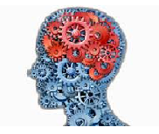
AI task
Perform actions in it (robotics)
Robotics
Perceive the world (computer vision)
Communicate with other agents and human beings
Perception
Language
Learning
Knowledge
Learn from data and adapt over time
Have knowledge about the world
Reasoning
Draw inferences and make decisions.
Machine learning has become the primary driver of many of the AI applications

Slide 13
Solving AI tasks?
Modeling
Inference
Learning
Modelling -- Inference – Learning
Paradigm

Slide 14
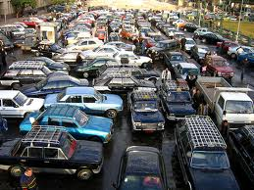
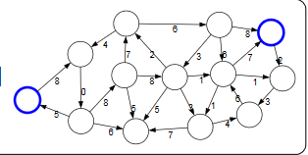
Task : Find the shortest path for navigation
Model is a representation of a system from a particular perspective
Real World
Model
Modeling
Modeling takes real world problems and convert them into formal mathematical objects called models

Slide 15
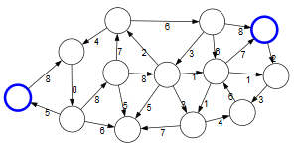
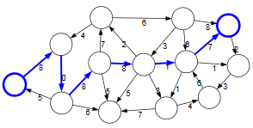
Model
Predictions
Inference
Given a model, the task of inference is to answer questions with respect to the model.

Slide 16
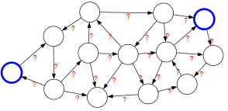
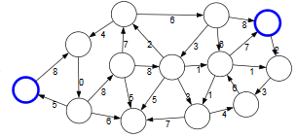
Model without parameters
Model with parameters
Data &
Learning
Idea behind (machine) is to get the model from data and tune the parameters.
learning

Slide 17
Ability to automatically learn and improve from experience without being explicitly programmed
Artificial Intelligence
AI - Intelligence demonstrated by machines
Machine Learning
ML- Giving computers the skill to learn without explicit programming
Deep Learning
DL – Subset of ML, examining algorithms that learn and improve on their own

Slide 18


Traditional Program
ML Program
l
l
Data
Computer
Data
Computer
Output
Program
Program
Output
Input Data
l
Input Data
 | A1 | A2 | A3 | A4 | A5
P1 | 1 | 0 | 1 | 1 | 1
P2 | 0 | 1 | 0 | 0 | 1
P3 | 1 | 0 | 1 | 0 | 1
P4 | 1 | 0 | 1 | 1 | 0
P5 | 0 | 1 | 0 | 1 | 0
 | A1 | A2 | A3 | A4 | A5
P1 | 1 | 0 | 1 | 1 | 1
P2 | 0 | 1 | 0 | 0 | 1
P3 | 1 | 0 | 1 | 0 | 1
P4 | 1 | 0 | 1 | 1 | 0
P5 | 0 | 1 | 0 | 1 | 0
Computer
Result
Computer
Yes, 1 occurrence
 | Has glaucoma?
P1 | Y
P2 | N
P3 | Y
P4 | Y
P5 | N
Search Program
Y = f (A1,A2,A3,A4,A5)
Query
Does an instance (1, 0, 1, 1, 0) exist?
1/9/2023
Output
18/77

Slide 19
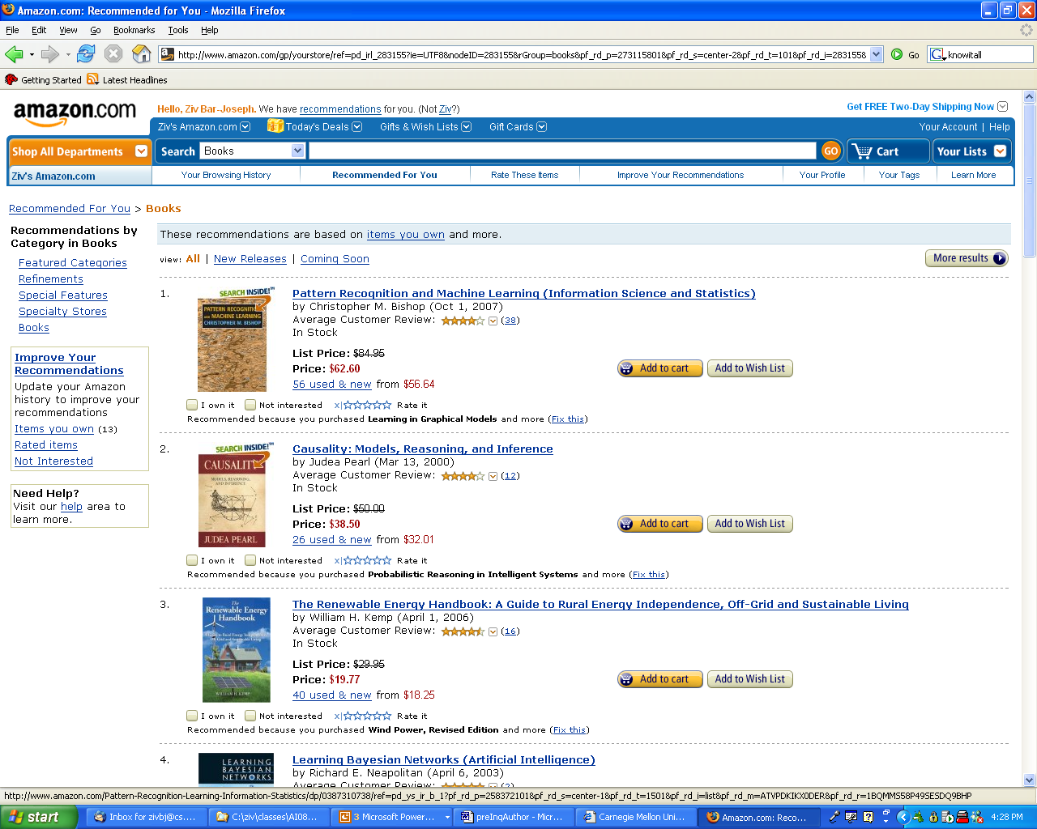

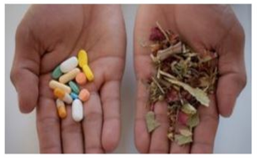
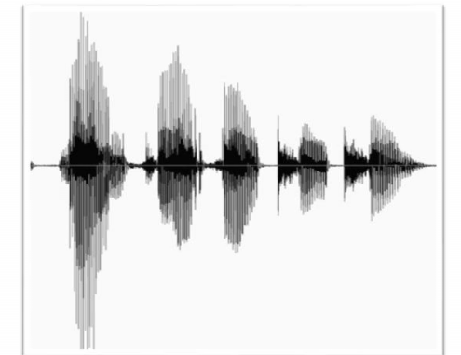
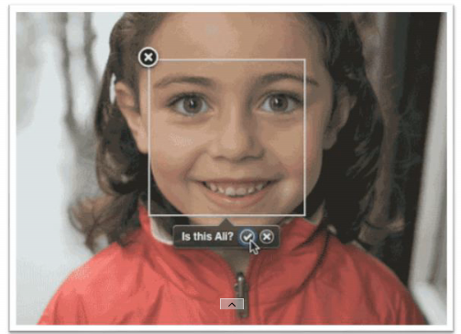
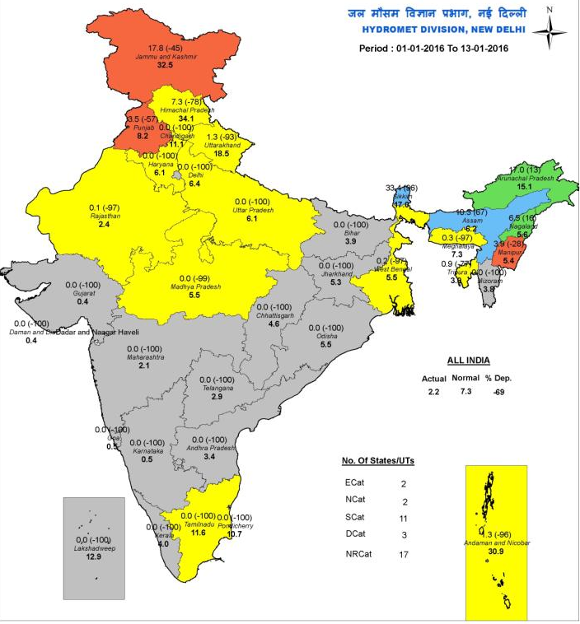
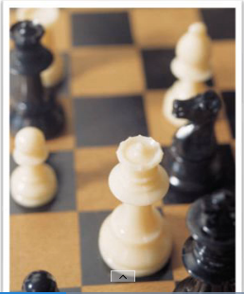
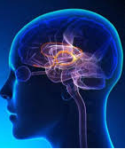
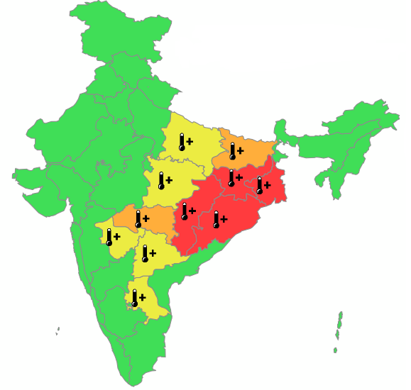
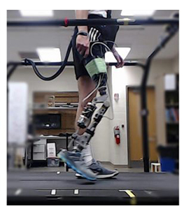
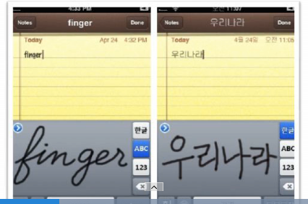
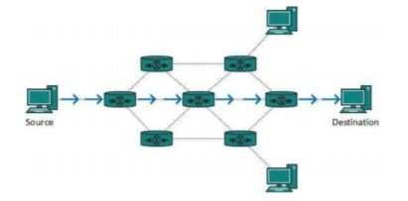
Search Engine
Recommendations
Speech Recognition
Medical Traits
Face Recognition
Rain fall Prediction
Game Playing
Medical Imaging
Heat Wave Prediction
Prosthetics
Hand Writing Recognition
Network
Routing

Slide 20
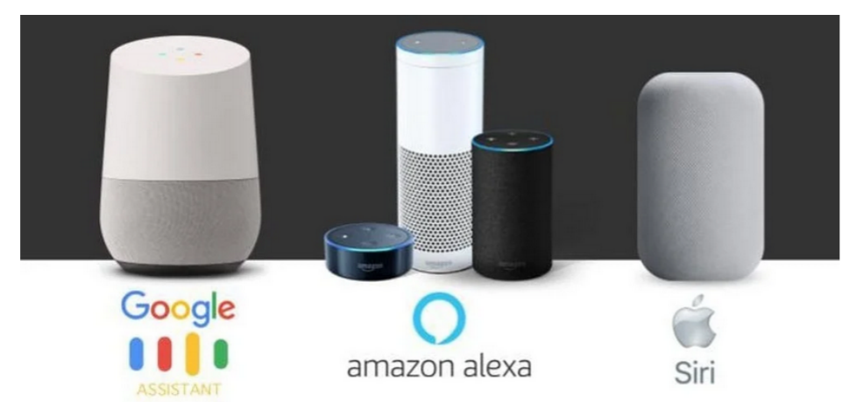
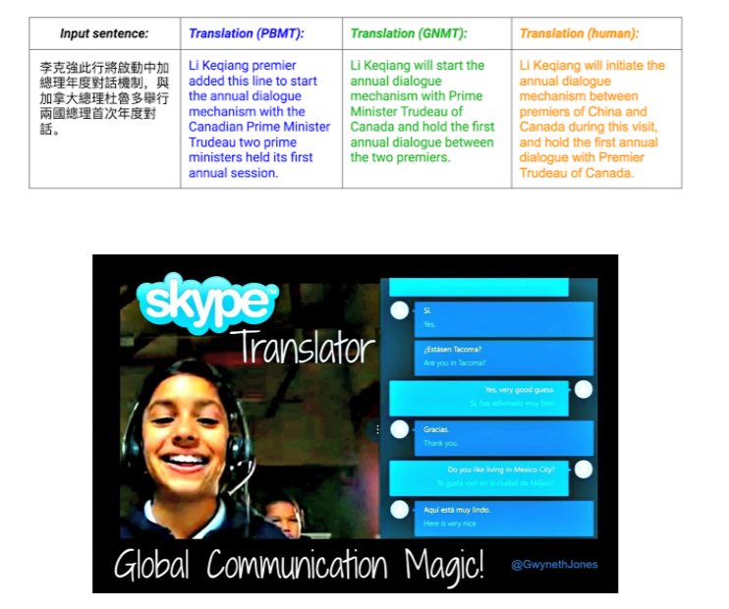
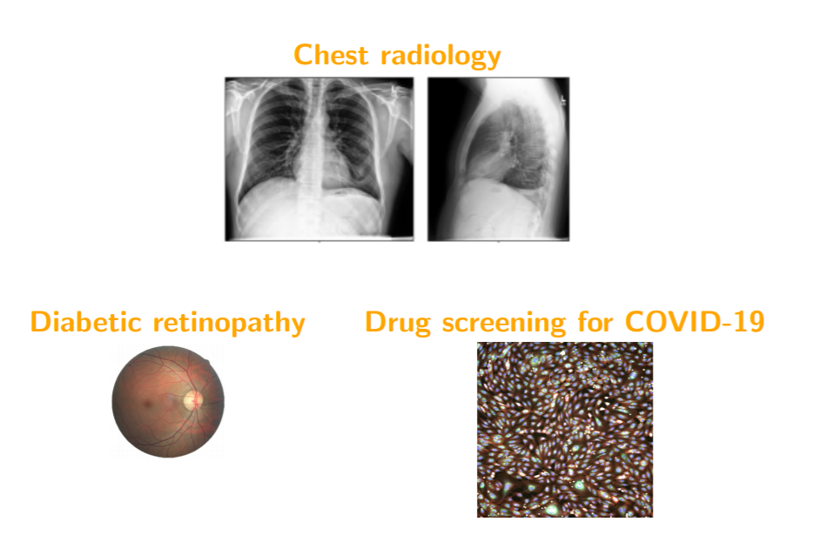
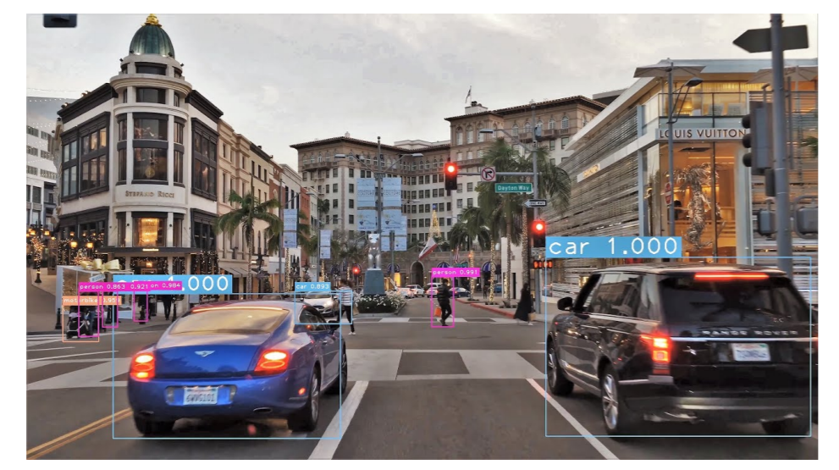
Machine translation
Virtual assistants
Health care
Autonomous driving

Slide 21
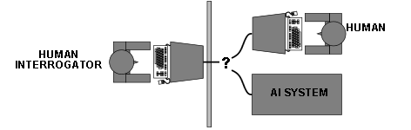
Agent
Turing(1950) “Computing machinery and intelligence“:
Can machines think? An imitation game

Slide 22
Software Agent
Software that gathers information about an environment and takes actions based on that
a robot
a web shopping program
a traffic control system...
Computational agents behave autonomously

Slide 23
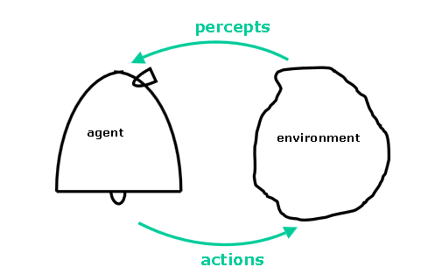
Agent and Environment
An agent is anything that can be viewed as perceiving its environment through sensors and acting upon that environment through effectors.
A robotic agent substitutes cameras and infrared range finders for the sensors and various motors for the effectors.
A software agent has encoded bit strings as its percepts and actions.

Slide 24
Components of an AI problem?
Initial State
Actions
Result
Goal State
Path cost function

Slide 25
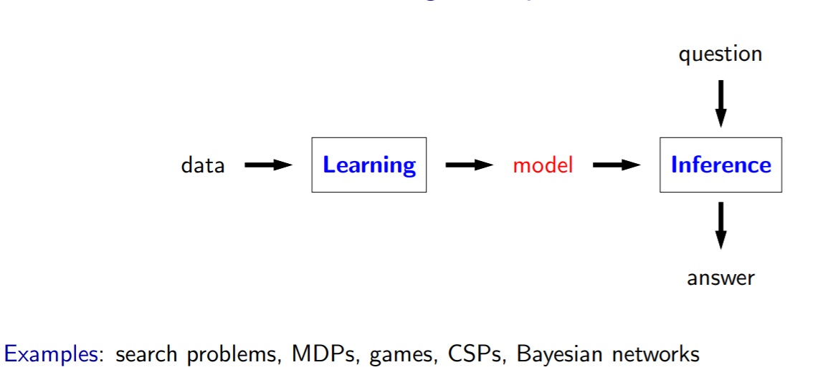
Modelling

Slide 26
Search Problems
What is the minimum cost path?
Inference as finding minimum cost paths in a graph
Inference algorithms such as DFS, UCS or A* produced the minimum cost path.

Slide 27
MDP and Games
what is the maximum value policy?
Inference algorithms such as value iteration or minimax produced this.
Learning algorithms such as Q-learning or TD learning.

Slide 28
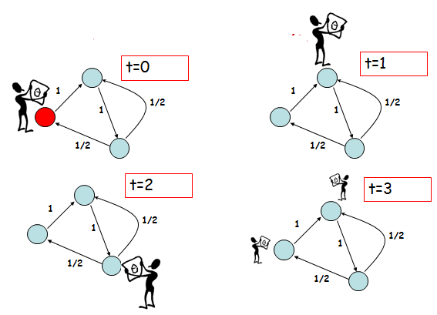
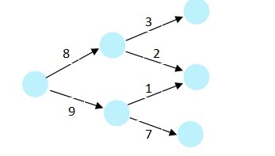
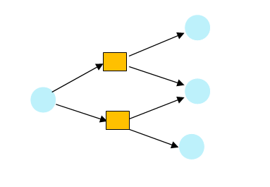
State based models
Search Problems : You control everything
Markov Decision Process: Blackjack
Adversarial Games : Adversary Controls

Slide 29
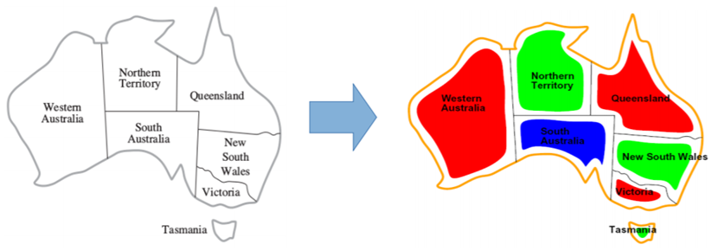
Constraint Satisfaction
”what is the maximum weight assignment?”
inference as finding maximum weight assignments or computing conditional probabilities.
Inference algorithms such as backtracking search, beam search, or variable elimination to find such an assignment

Slide 30
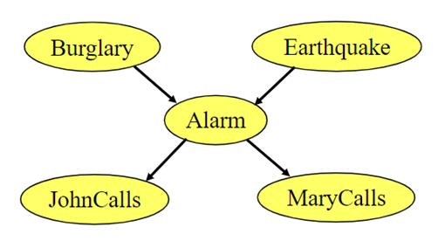
Bayesian Network
What is the probability of a query given evidence?”
Inference algorithms such as Gibbs sampling and particle filtering
we can learn them using maximum likelihood estimators

Slide 31
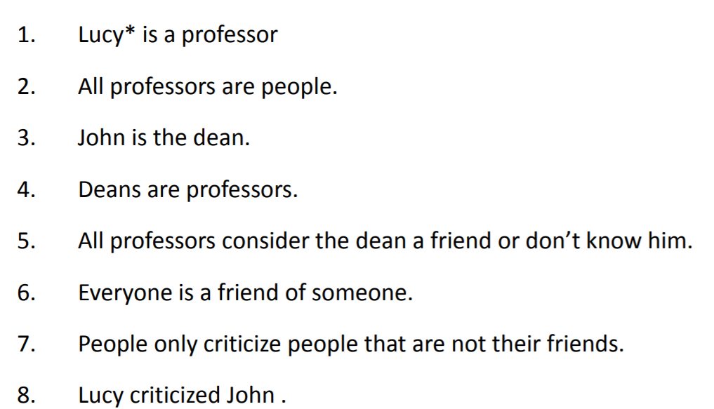
Logic based Models
inference is applying a set of rules
Is Lucy a friend of John?

Slide 32
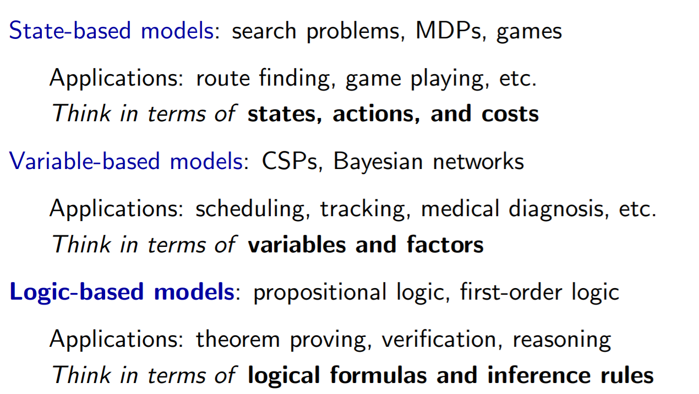
Modelling Paradigms

Slide 33
